Slide 1
CME Compliance: Disclosure
All CME activities are required to disclose to learners the relationship faculty, planners, authors or anyone in a position to influence the content of a CME activity, has with commercial interests.
A commercial interest is defined as any entity producing, marketing, re-selling, or distributing health care goods or services consumed by, or used on, patients.

Slide 2
CME Compliance: Disclosure
The mechanism we use to obtain this information is by using a disclosure form.
  The disclosure form collects information regarding whether the faculty, author, planner, or his/her spouse has received anything of value from a commercial interest within 12 months of the start date of the activity

Slide 3
CME Compliance: Disclosure
The disclosure form has spaces for the faculty or planner to attest to financial relationships (or lack thereof) and list the names of commercial entities, what was received, and what role in the commercial interest.
The disclosure form also lists two additional questions for agreement to follow LSU content validity statement and FDA off-label content validation for non FDA-approved uses of drugs or devices.

Slide 4
CME Compliance: Disclosure
You can access templates of the disclosure form on the LSU website: http://www.medschool.lsuhsc.edu/medical_education/CME/Forms.asp

Slide 5
CME Compliance: Disclosure
Once you have collected the disclosure form from your faculty, their disclosure information (or lack thereof) needs to be communicated to the audience. This communication is insured in two ways:
  Program overview handouts
  Disclosure slides

Slide 6
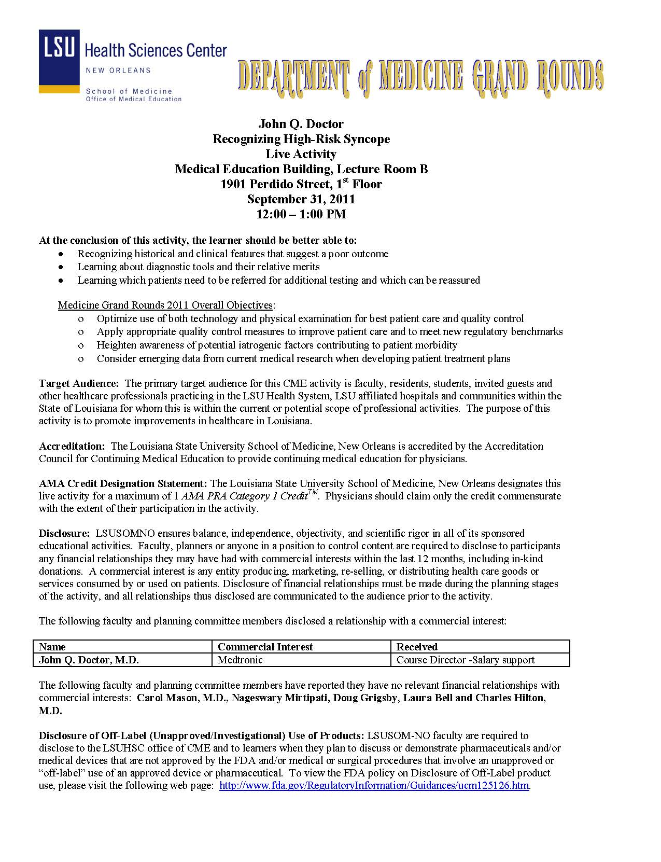
CME Compliance: Disclosure
The program overview
sheet is handed out to
all participants in a CME
activity, and contains
learning objectives,
accreditation
information, and
communicates faculty
disclosures (or lack
thereof).

Slide 7
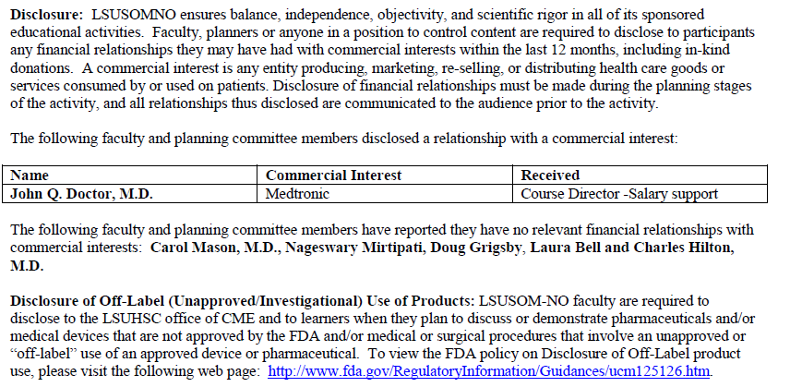
CME Compliance: Disclosure
Example #1: John Q. Doctor disclosed that he received salary support as a course director for Medtronic. Below is how this information should appear on the program overview sheet:
Role/what was received
Name
Commercial interest

Slide 8
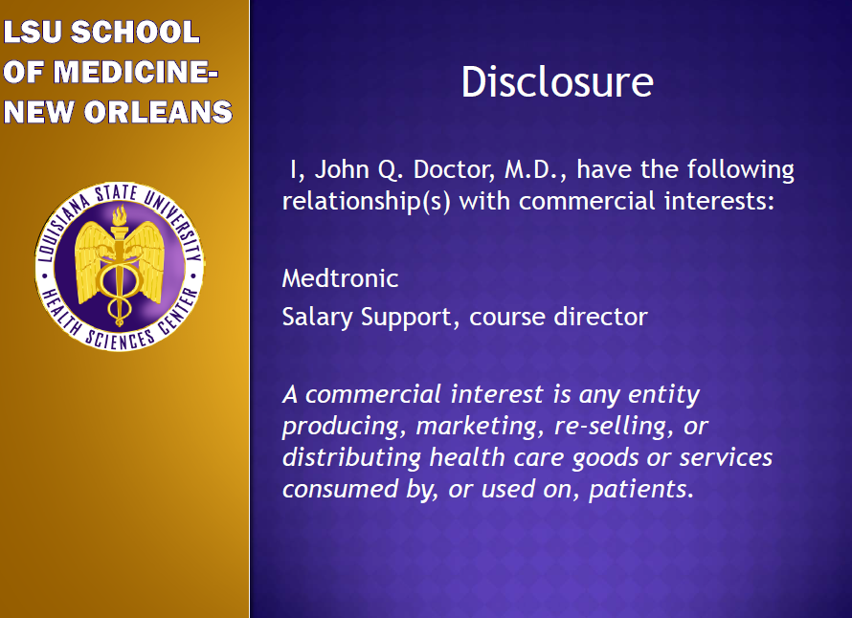
CME Compliance: Disclosure
Dr. Doctor must
also include a
disclosure slide
with this
information at
the beginning of
his presentation:

Slide 9
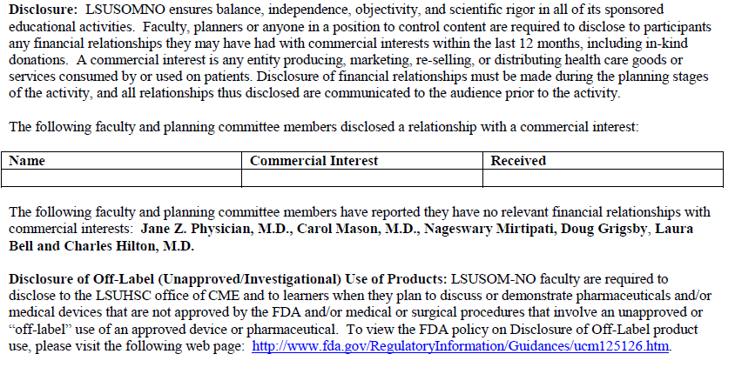
CME Compliance: Disclosure
Example #2: Jane Z. Physician indicated on her disclosure form that she has no relationships with commercial interests. When this is the case, the name is listed along with any activity planners as having no relationships:

Slide 10
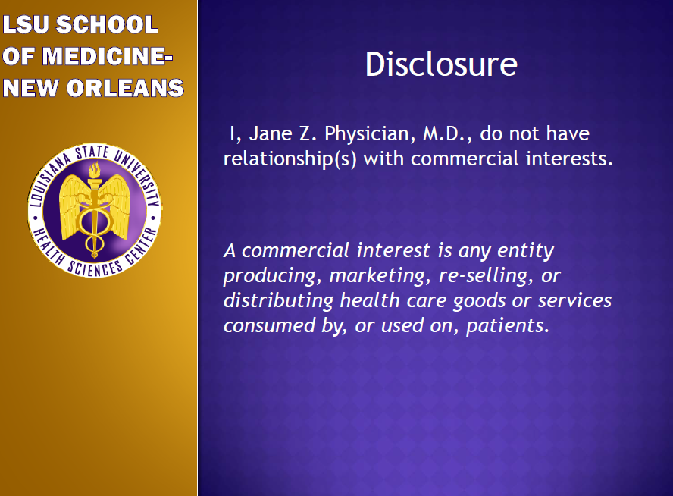
CME Compliance: Disclosure
Dr. Physician’s
disclosure slide
in her presentation
will look like this:

Slide 11

CME Compliance: Disclosure
If the presentation
is the first or only
one in the activity,
an accreditation
slide must also be
included before the
disclosure slide.

Slide 12
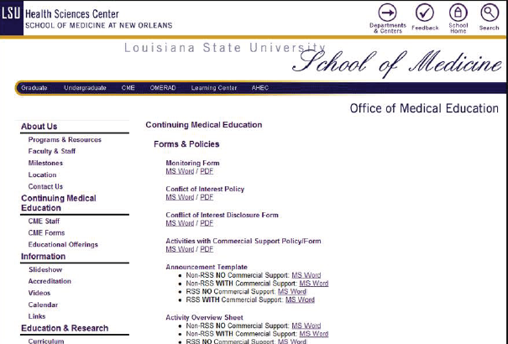
CME Compliance: Disclosure
Both of these slides can
be downloaded and
tailored for use in your
activity at the LSU CME
website: http://www.medschool.lsuhsc.edu/medical_education/CME/Forms.asp

Slide 13
CME Compliance: Disclosure
Post-Test: Disclosure Procedures
Question:
Dr. Smith is planning a CME talk for the
Department of Medicine. She wants to invite a
guest speaker for this event and has asked John,
a coordinator in the department, to collect the
necessary paperwork. Who does John need to
get disclosures from?

Slide 14
CME Compliance: Disclosure
Post-Test: Disclosure Procedures
Answer:
The guest speaker
Dr. Smith and the guest speaker
Dr. Smith
The guest speaker, Dr. Smith, and himself

Slide 15
CME Compliance: Disclosure
Post-Test: Disclosure Procedures
Answer:
The guest speaker
Dr. Smith and the guest speaker
Dr. Smith
The guest speaker, Dr. Smith, and himself
Disclosure forms must be collected by all faculty and planners involved in a CME activity.

Slide 16
CME Compliance: Disclosure
Post-Test: Disclosure Procedures
True or False:
Faculty must make the audience aware of their
disclosure information (or lack thereof) verbally
in their presentations.

Slide 17
CME Compliance: Disclosure
Post-Test: Disclosure Procedures
True or False:
Faculty must make the audience aware of their
disclosure information (or lack thereof) verbally
in their presentations.
False. Faculty may mention this information, but they must also present disclosure information on a slide at the beginning of the presentation. Disclosure information must also be presented on an activity overview that is handed out to the audience.

Slide 18
CME Compliance: Disclosure
Post-Test: Disclosure Procedures
True or False:
Planners of LSU CME activities need to design
and generate their own disclosure forms,
overview sheets, and disclosure slides.

Slide 19
CME Compliance: Disclosure
Post-Test: Disclosure Procedures
True or False:
Planners of LSU CME activities need to design
and generate their own disclosure forms,
overview sheets, and disclosure slides.
False. Planners can download templates needed for all required materials on the LSU CME web page.

Slide 20
CME Compliance: Commercial Support
QUESTIONS?
Please contact the LSU CME office at (504) 568-2000 or email Doug Grigsby at dgrigs@lsuhsc.edu

